Slide 1


Estimation of Obesity Levels Based on Eating Habits and Physical Condition
ML model on

Slide 2
Introduction :
This dataset include data for the estimation of obesity levels in individuals from the countries of Mexico, Peru and Colombia, based on their eating habits and physical condition.
The data contains 17 attributes and 2111 records, the target record is labeled with the class variable NObesity (Obesity Level), this allows classification of the data using the values of Insufficient Weight, Normal Weight, Overweight Level I, Overweight Level II, Obesity Type I, Obesity Type II and Obesity Type III.
In this project, the main source of data is a study of 2,111 people aged between 14 and 61 years. This data was collected using survey.
Attributes in this project are Frequent consumption of high caloric food, Frequency of consumption of vegetables, Number of main meals, Consumption of food between meals, Consumption of water daily , Consumption of alcohol, Calories consumption monitoring , Physical activity frequency, Time using technology devices, Transportation used, Gender, Age, Height, Weight, Family history with overweight and SMOKE.
Out of total variables 8 attributes are numerical and 9 are categorical.

Slide 3
Objective :
Obesity can cause many physical health problems and affect people’s quality of life. So people are starting to look at the factors that lead to obesity and predict the emergence of obesity.
Obesity is becoming problematic as it causes cardiovascular diseases and many developing nations are facing this type of problem.
So the main objective of this project is to develop a machine learning model for predicting obesity level based on persons eating habits, physical condition and other factors.

Slide 4
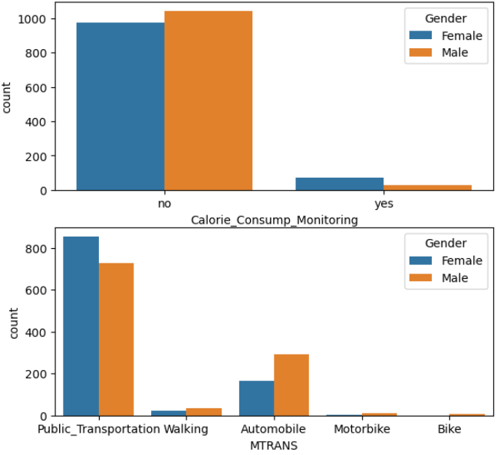
Modules & Workflow of project:
Importing data
Exploratory data analysis
Handling missing values
Handling outliers
Handling categorical features
Feature scaling
Assumption check
Feature selection
Sampling the data
Training different models
Hyper tuning
Result
Deployment on Cloud
Figure – Count plot of Calorie monitoring and Mode of transportation

Slide 5
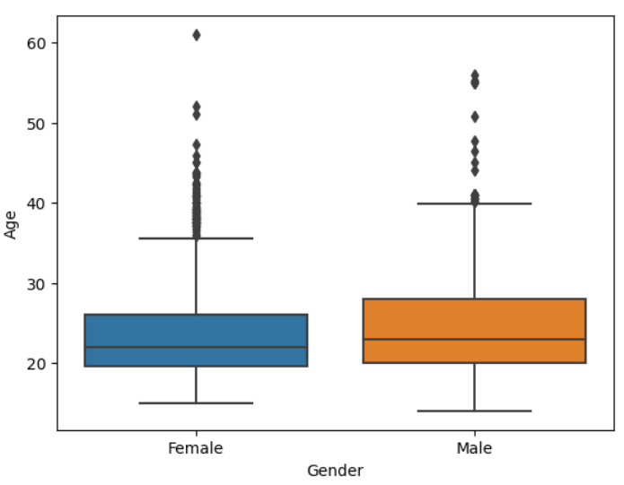
Tools / Platform & ML Algorithms:
In this project for python coding I have used Jypyter Notebook of Anaconda distribution.
For creating dashboard – PowerBI, TABLEU
Deploying the Model – AWS
ML Algorithms – Logistic Regression, Decision Tree, K Nearest Neighbour, Support Vector Classifier, Random Forest
Figure – Box plot of Gender w. r. t. Age

Slide 6
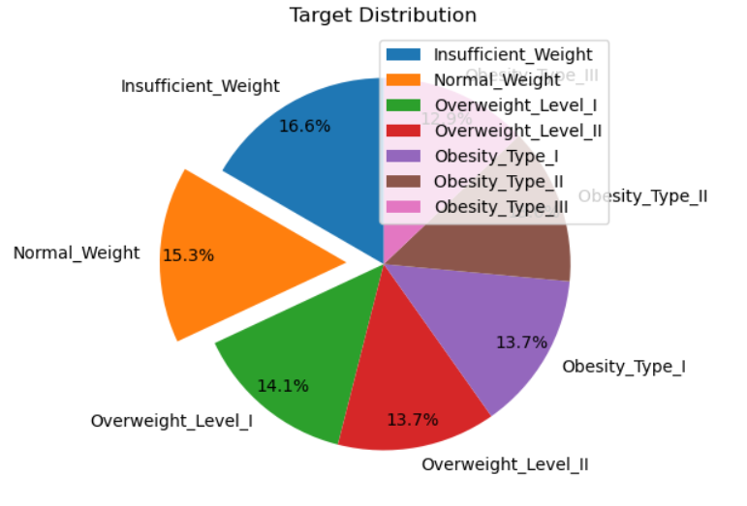
Methodology:
The purpose of this project is to make people aware of the risk of obesity based on some key factors of their lifestyle, for which a computational intelligence model is created.
Around 50-60 % time was given to Exploratory Data Analysis and Data Preprocessing.
In this project I have used 80 % data set for training the model and remaining 20 % for testing purpose.
The following metrics were evaluated: accuracy, AUC, F1-score, precision and recall for each algorithm used. Based on these metrics, the algorithm that had the best performance when classifying the data was determined.
Figure – Pie chart of Dependent variable

Slide 7
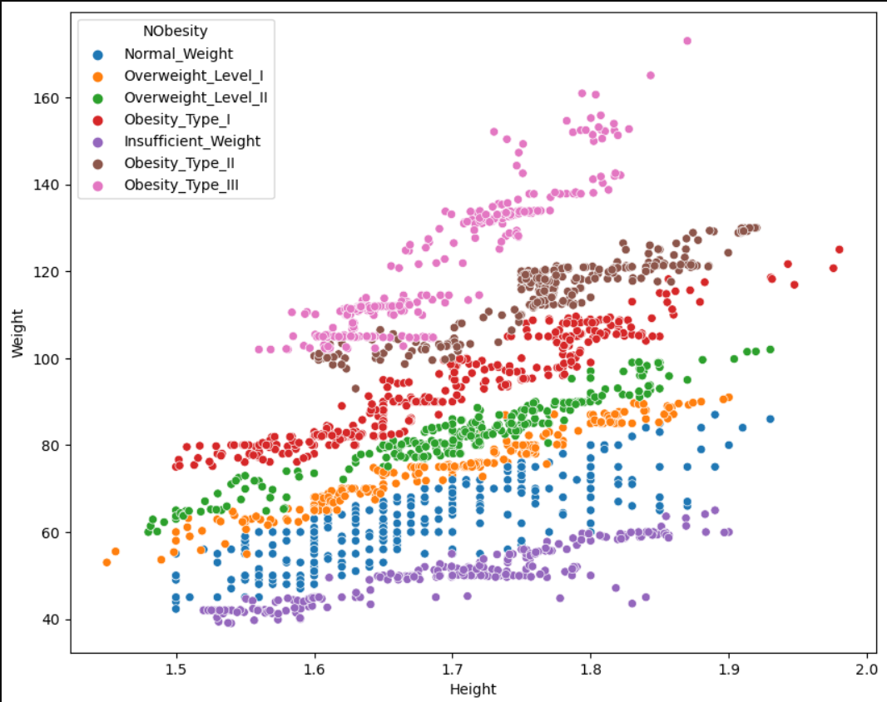
Challenges:
The Logistic Regression algorithm doesn't require assumptions like Linear Regression but it only needs data to be in normal distribution. In the project all the continuous attributes were converted to normal distribution except Number of Meals variable.
In the dataset outliers were there in Number of Meals, Height, weight and Age column.
Almost all the algorithms were overfitting the test set.
Figure – Scatter plot of Weight vs Height

Slide 8
Advantages:
In this project, a method based on ML algorithm is created, using supervised and unsupervised classification techniques.
We all have witnessed Covid19 pandemic and since the pandemic people are becoming more health conscious than before. And currently the trend of online fitness apps or health monitoring apps is increasing. So this model can be very useful for online platforms for reaching potential customers.
This model can be very useful for performing online surveys and find about population obesity status for minimizing cardiovascular risk.
Disadvantages:
This model was created based on survey done in Mexico, Peru and Colombia. It focuses on particular population. So for different regions this model might suffer.

Slide 9
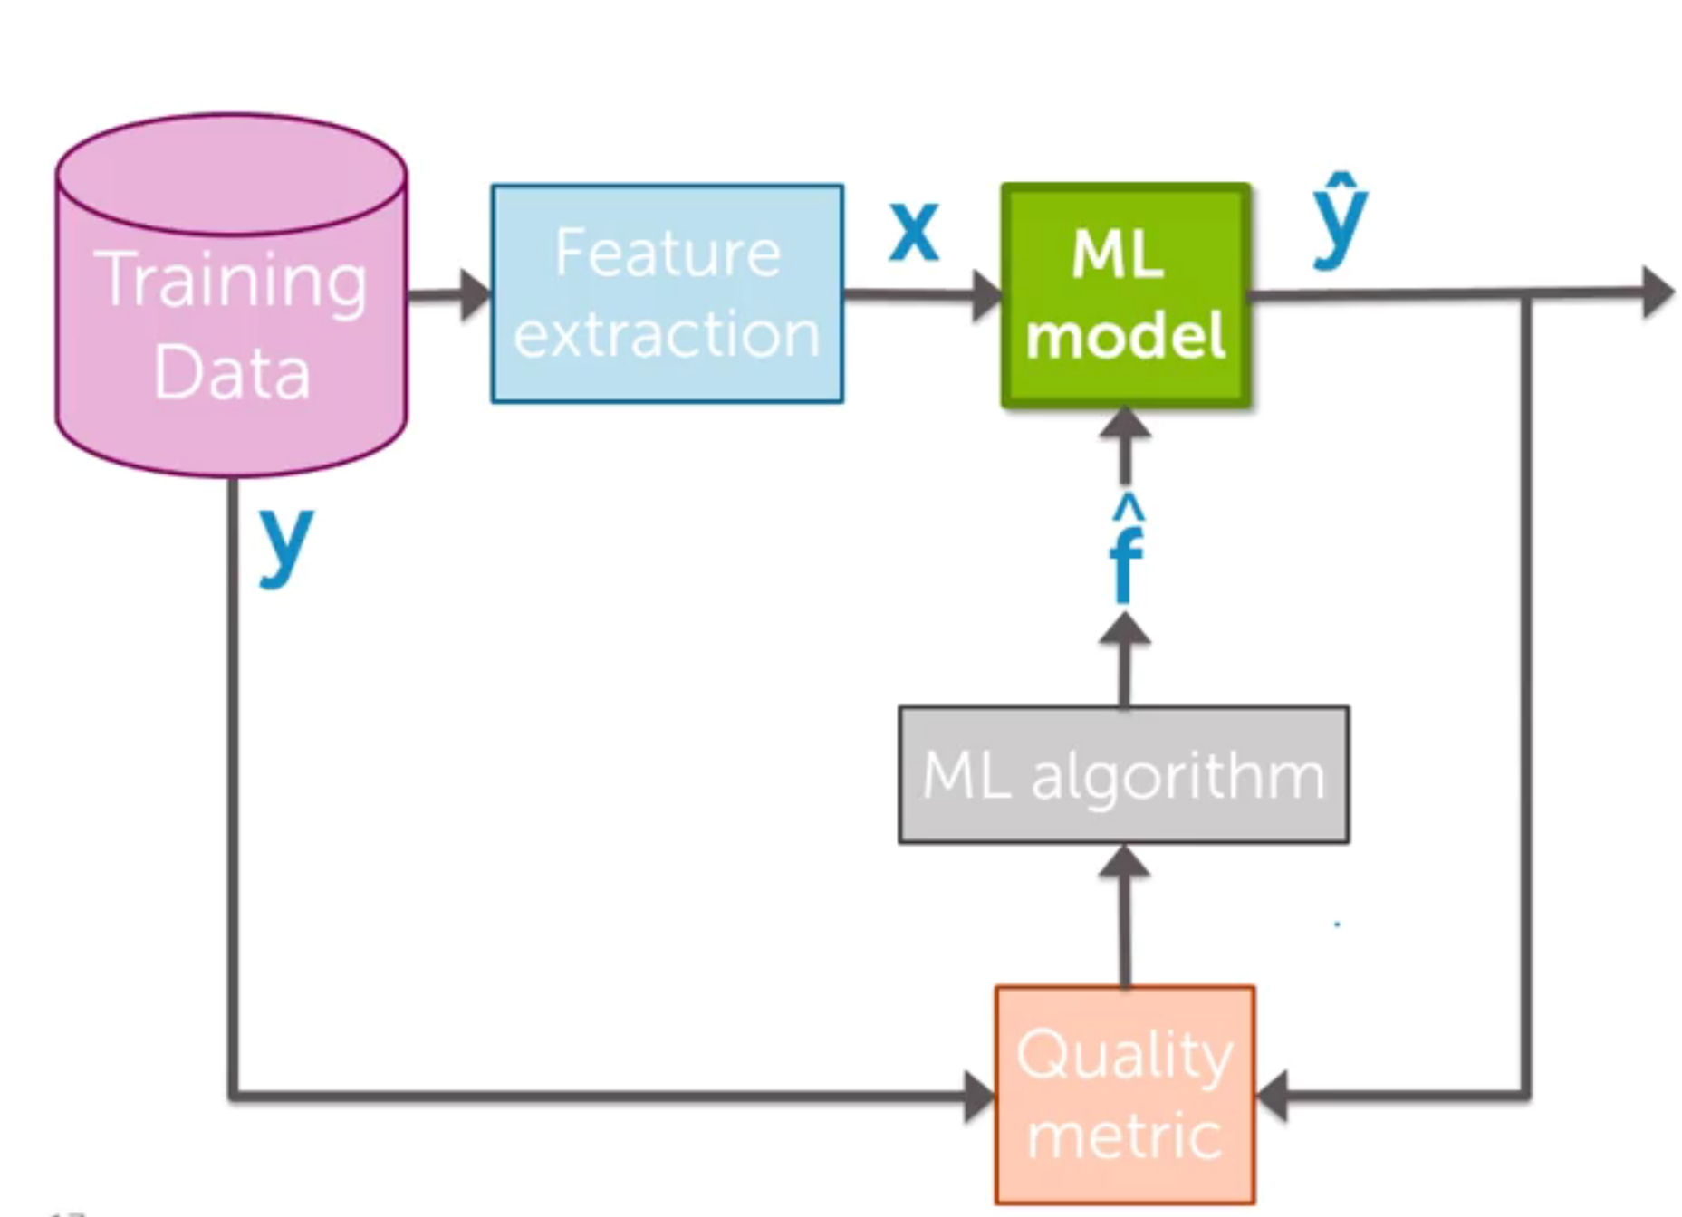

Learnings:
Time Management
Importance of Data Preprocessing
Selection of ML algorithms
Importance of hyper tuning.

Slide 10
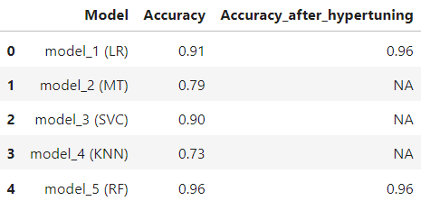
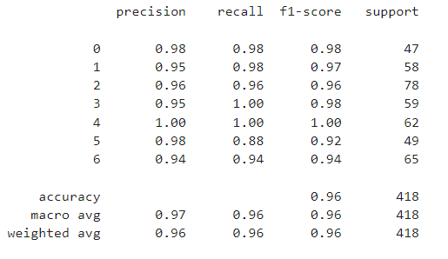
Result:
Figure- Result Table of all 5 models
Figure- Classification Report of hyper tuned logistic regression model
As mentioned in above data frame model_1 and model_5 i.e. Logistic Regression and Random Forest Classifier performed better in predicting obesity status.
Before performing hyper tuning only logistic regression has given generalized model with accuracy of 91 % but same after hyper tuning goes up to 96 %.
In case of Random Forest after performing hyper tuning the model is generalized with accuracy of 96 %.

Slide 11
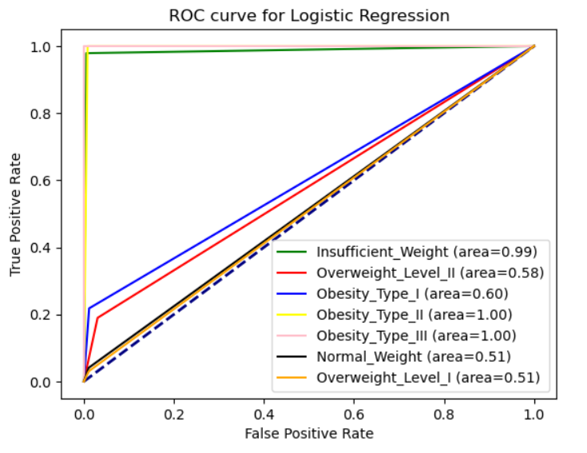
Result:
In this data Logistic regression and Random forest models performed very well with accuracy of 96%.
From the above ROC curve of Logistic Regression we can say that model performs better in predicting values of Insufficient Weight, Obesity Type II and Obesity Type III.

Slide 12
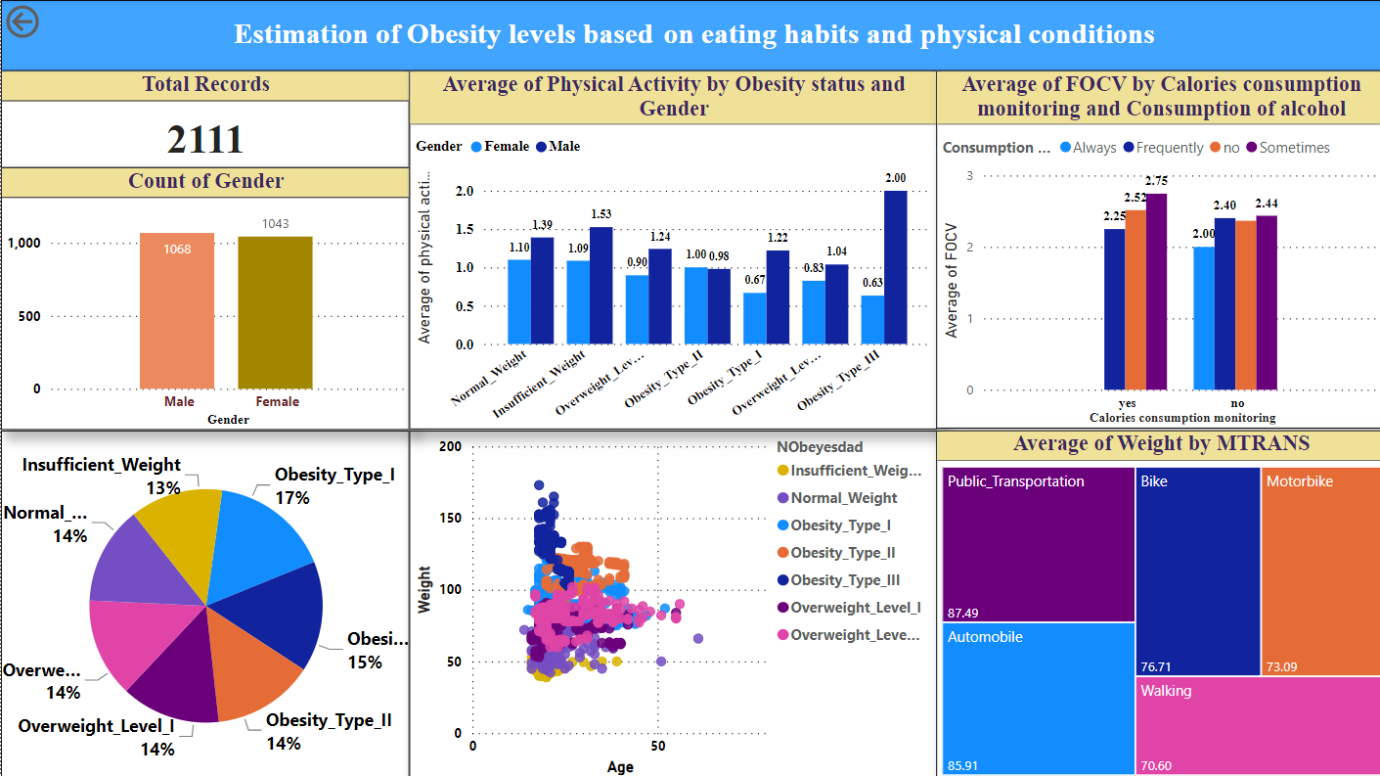
Dashboard:

Slide 13
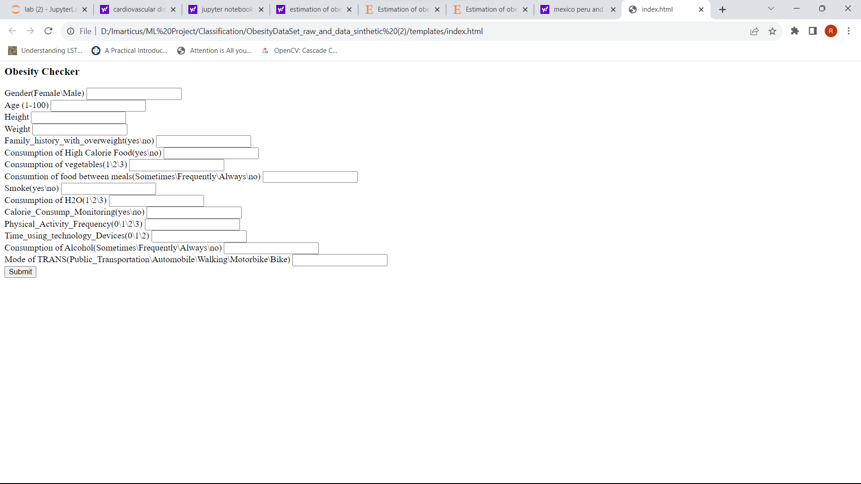
ML on Cloud:

Slide 14
Thank You

